Slide 1
Rent and Royalty Income
Pub 4012 – Tab D Pub 4491 – Lesson 13
Notes:
This entire lesson is comprehensive, intended for experienced counselors, somewhat because these items are not often seen.
Local instructors can teach this topic to all volunteers if the district sees more land rent or royalty income.
It is best if counselors review pubs 4491 and 4012 on this topic before coming to class

Slide 2
Lesson Topics
Rental income
Rent of personal residence fewer than 15 days
Royalty income
Reporting royalty income on Schedule C when self-employment income
TaxSlayer entries
Royalty income on Schedule K-1

Slide 3
Rent and Royalty Scope
Rent and royalty in scope for
Unimproved land rent
Royalty
Form 1099-Misc or taxpayer stated
Schedule K-1 in scope for
Royalty
Not Rent

Slide 4
IRS Link and Learn Job Aids
FAQs - Can I Claim Rental Expenses?
Interactive Tax Assistant – Can I Deduct My Mortgage Related Expenses?

Slide 5
Rental Income
Rent
Periodic payment by tenant to landlord in return for use of land, building, apartment, office, or other property
Does not include a cost-sharing arrangement
roommate or household member contributing monetarily
should not exceed the allocable actual costs

Slide 6
Rental Income
Rental income in-scope if
Land or gas/oil lease
Reported on a Form 1099-MISC or
Taxpayer states received from individual and no Form 1099-MISC
No Expenses except property tax
Report on Schedule A
Rent reported on a Schedule K-1 – Out of scope
Notes:
If taxpayer is not itemizing or if their state taxes exceed the $10,000 cap, there is no benefit to the additional Sch A deduction.
Refer taxpayers to professional preparer if they will be negatively impacted by our scope limitations

Slide 7
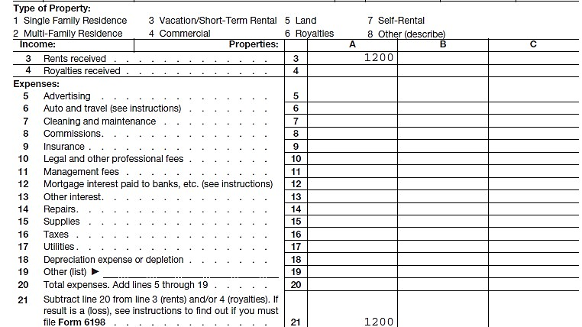
Rental Expenses
No Expenses Allowed on Schedule E

Slide 8
Rent of Personal Residence for fewer than 15 Days
Property used as personal residence and rented fewer than 15 days during tax year
Rent not reported on tax return
Exception: Form 1099-MISC received
Do not deduct rental expenses
can deduct interest and taxes per normal rules on Schedule A
Notes:
1099-MISC received see next slide

Slide 9
Rent of Personal Residence for fewer than 15 Days
If Form 1099-MISC received for fewer 15 days rental
Enter the Form 1099-MISC rent income and
Deduct same amount as “other expense” describe as “fewer than 15 day exclusion”
Note: taxpayer must have used property as personal residence for 15 days or more

Slide 10
Royalty Income
Royalties from gas/oil lease in-scope if reported on Schedule K-1 or Form 1099-MISC
Report on Schedule E
No deductions allowed – including depletion – refer to professional preparer
Royalties from self-employment (such as an author, inventor, artist, etc.) is business income reported on income on Schedule C
Taxpayer may be eligible for the Self-employed Health Insurance adjustment and Qualified Business Income (QBI) Deduction
Notes:
All Form 1099-MISCs must be input into TaxSlayer
Royalty from own personal services/self-employment is reported on Schedule C: See slide deck 25 Income from 1099-MISC for correct TaxSlayer input. Counselors need to check if any health insurance premiums were paid by the taxpayer (including Medicare) to provide the self-employed Health Insurance adjustment.

Slide 11
Royalty Income in TaxSlayer
TaxSlayer prompts Schedule E when Form 1099-MISC box 2 entry is made
Royalties automatically selected
Box 2 royalties from self-employment should be entered in box 7 (Nonemployee Compensation) in TaxSlayer
No Form 1099-MISC received – open Schedule E or C as appropriate

Slide 12
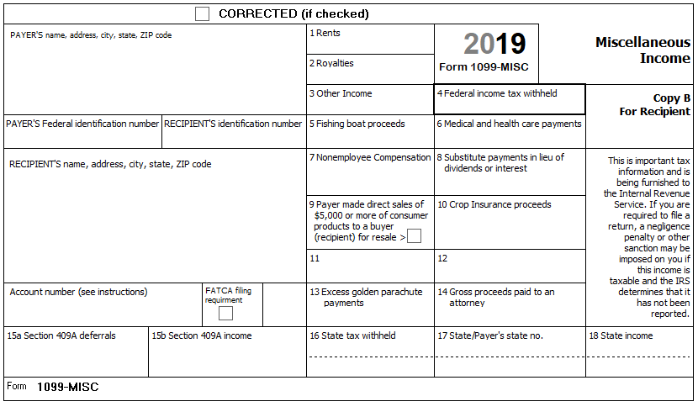
Form 1099-MISC
Royalties from self-employment:
Enter the amount reported in box 2 (Royalties) in box 7 (Nonemployee Compensation) to generate Schedule C
Notes:
Typically we report what we see. In this case, change the box entries when royalties are self-employment income.

Slide 13
Royalty Income on Schedule K-1
Enter data from Schedule K-1 in TaxSlayer
Income carries to Form 1040
See separate Schedule K-1 lesson

Slide 14
Quality Review
Confirm rent and royalty entries in-scope
Verify Form 1099-MISC entries
Verify royalty income correctly reported on Schedule E
Schedule C if from self-employment
Confirm Schedule E or Schedule C information entered correctly

Slide 15
Rents and Royalties
Questions?
Comments ...

